Slide 1
2022 Working at Iowa <insert org> Results
Spring 2023
Notes:
Cheryl:
Main Campus, UI Health care completed a survey powered by Press Ganey, allowing for comparison with patient satisfaction and benchmarking with other health care institutions
Survey ran from Oct 12-27, 2022
Survey included 20 questions and a validated engagement index

Slide 2
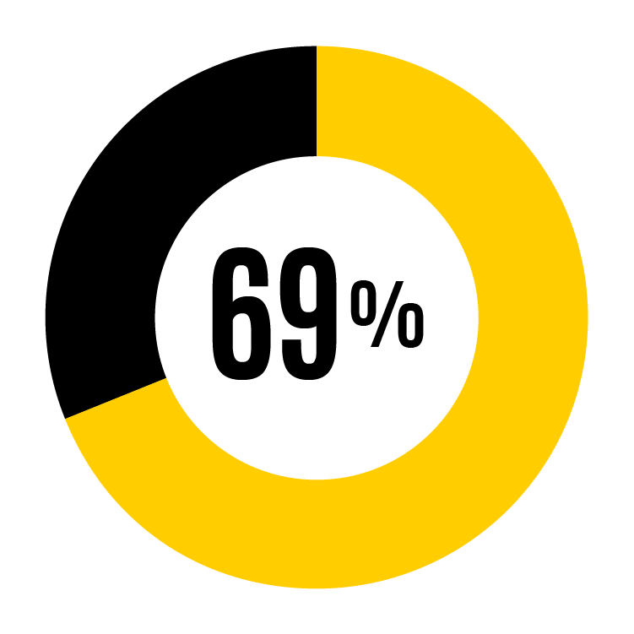
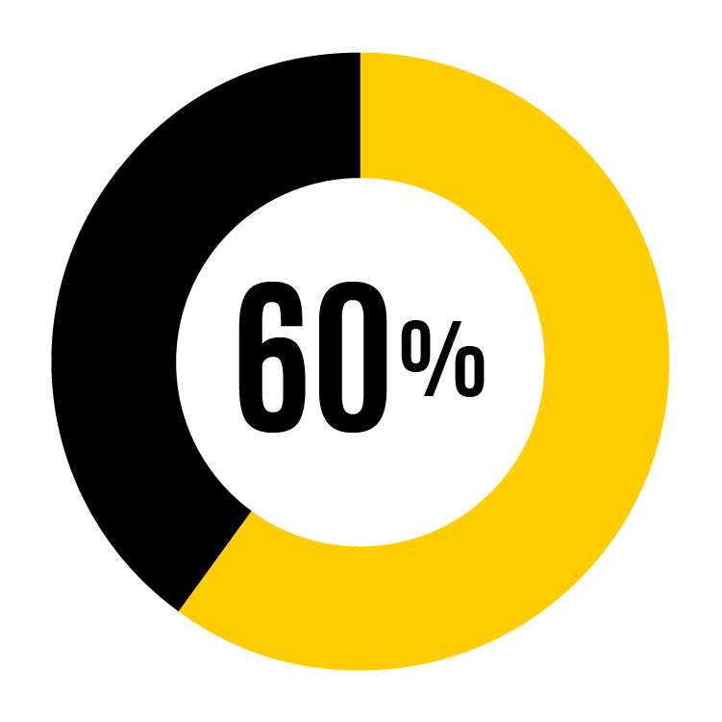
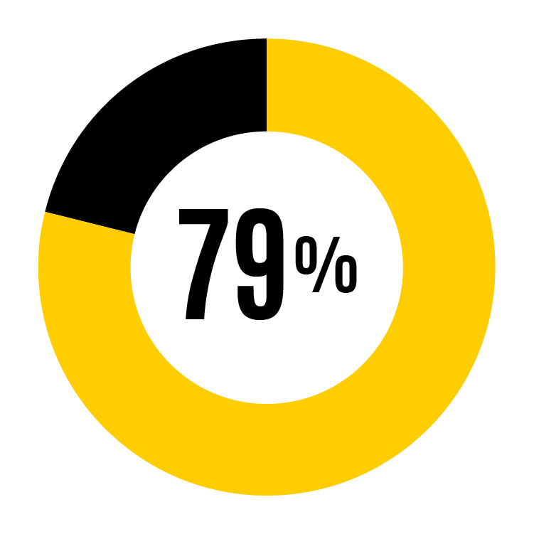
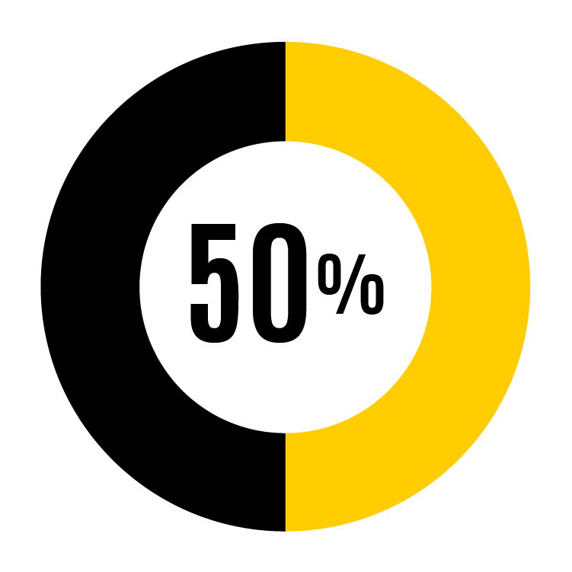
2022 response rates
Faculty and staff responses by job classification
Faculty
938 responding from 1,571 administered
P&S
2,858 responding from 3,609 administered
Faculty and Staff main campus responses
4,355 responding from 6,210 administered
faculty and staff that work 50%+
Merit
559 responding from 1,130 administered
Notes:
69% response rate is a highly reliable representation of university faculty and staff
This is the academic side of campus. No students, postdocs, or health care.

Slide 3
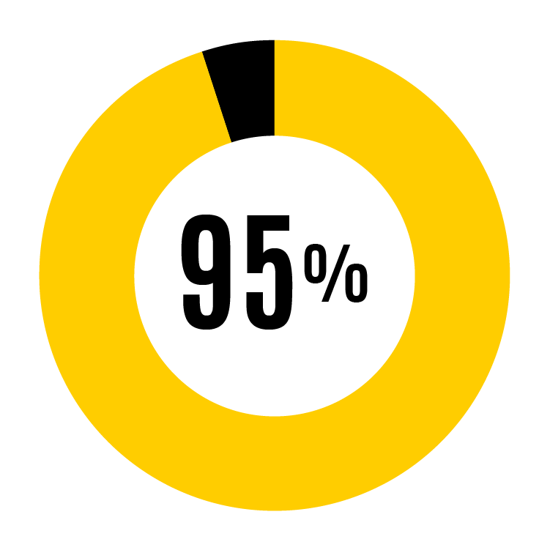
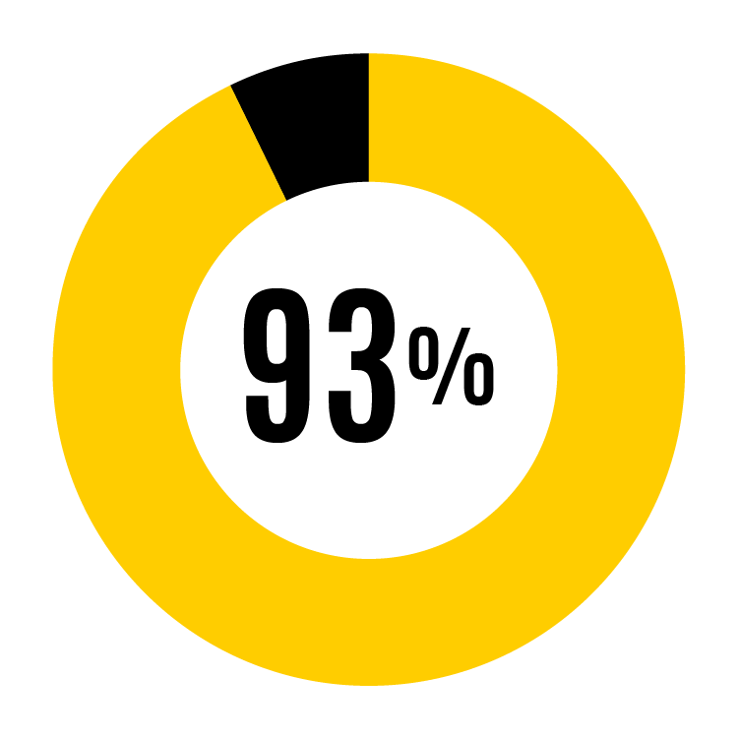
Strengths – All UI
I know my work expectations
I understand how my job fits with overall mission of UI
My supervisor treats me with respect
% of respondents who agreed (slightly agree, agree, strongly agree)
Notes:
UI faculty and staff consistently indicate widespread agreement with items related to role expectations, alignment with mission, and respect from supervisor.
These strengths have been consistent over time, and each earned over 90% agreement in the 2020 survey.
There was a notable increase in strongly agree scores between 2018 and 2022 with ‘my supervisor acknowledges my good work’, increasing from 40% to 48% strongly agree, suggesting supervisors are doing a better job than in the past with recognition.
% agreement to statements pertaining to supervisors are either trending upwards or flat. Supervisor training was launched in 2020 which may have had a positive impact on how employees perceive supervisors. Statements pertaining to supervisors include ‘I receive work feedback regularly’, ‘my supervisor’s feedback is helpful’, ‘my supervisor acknowledges my good work’, ‘my supervisor treats me with respect’ and ‘my supervisor is open to hearing concerns’.
2020 results
96% of employees value and understand what is expected of them in their work
95% understand how their job fits into the overall mission of the university
94% say that their individual unit has a strong focus on providing excellent service
92% agree that their supervisor treats them with respect

Slide 4
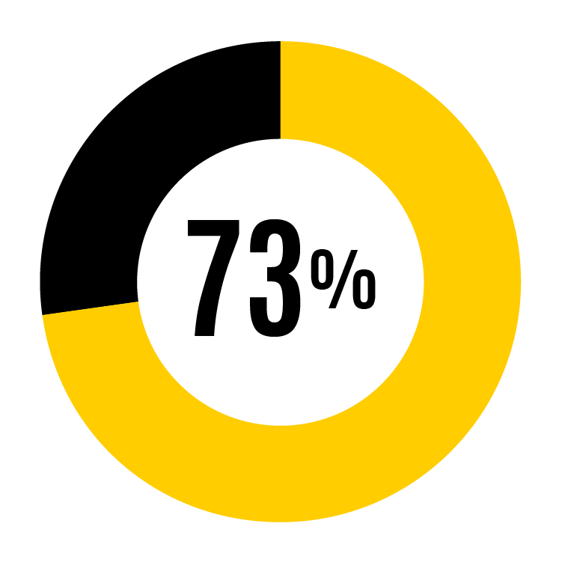
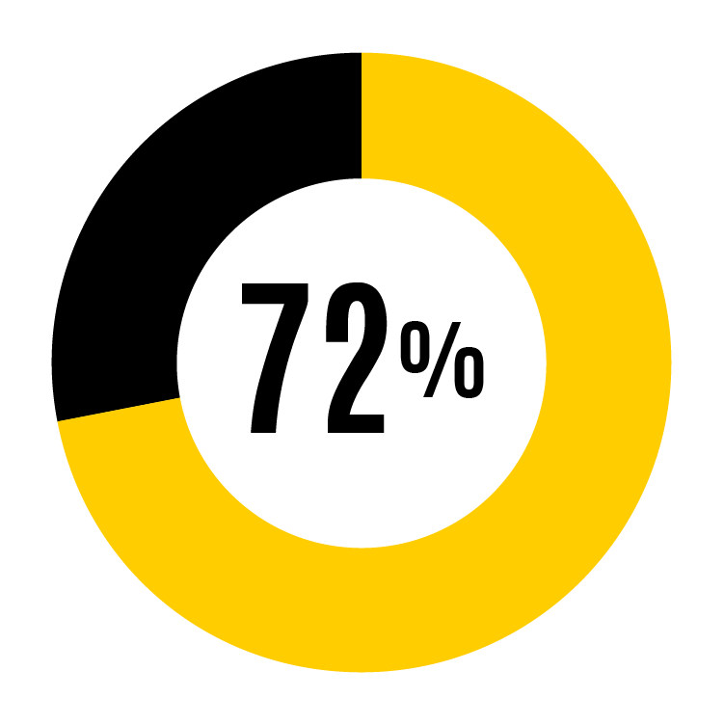
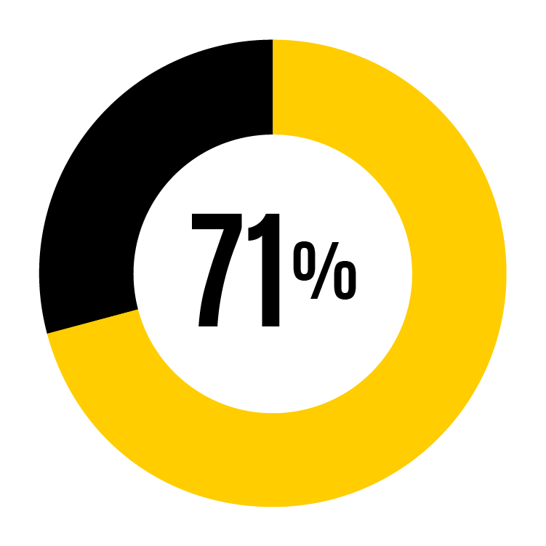
Opportunities – All UI
My unit distributes workloads fairly
UI recognizes accomplishments of faculty/staff
There are opportunities for promotion at UI
% of faculty and staff respondents who agreed (slightly agree, agree, strongly agree)
Notes:
Areas for improvement are also relatively consistent across survey years. Although they are the lowest scores, it is notable that more than 70% of faculty and staff agreed with each of these three statements – ‘my unit distributes workloads fairly, ‘ UI recognizes accomplishments of faculty and staff’ and ‘there are opportunities for promotion at UI’ - in 2022.
2020 results
•72% of employees agree that there are opportunities for promotion at the UI
•74% of employees agree that workloads in their unit are fairly distributed

Slide 5
Strengths – insert org specific data
Insert % from slide 6 or 7
Insert % from slide 6 or 7
Insert % from slide 6 or 7
insert org specific strength #1
insert org specific strength #2
insert org specific strength #3
% of faculty and staff respondents who agreed (slightly agree, agree, strongly agree)

Slide 6
Opportunities – insert org specific data
Insert % from slide 6 or 7
Insert % from slide 6 or 7
Insert % from slide 6 or 7
insert org specific opportunity #1
insert org specific opportunity #2
insert org specific opportunity #3
% of faculty and staff respondents who agreed (slightly agree, agree, strongly agree)

Slide 7
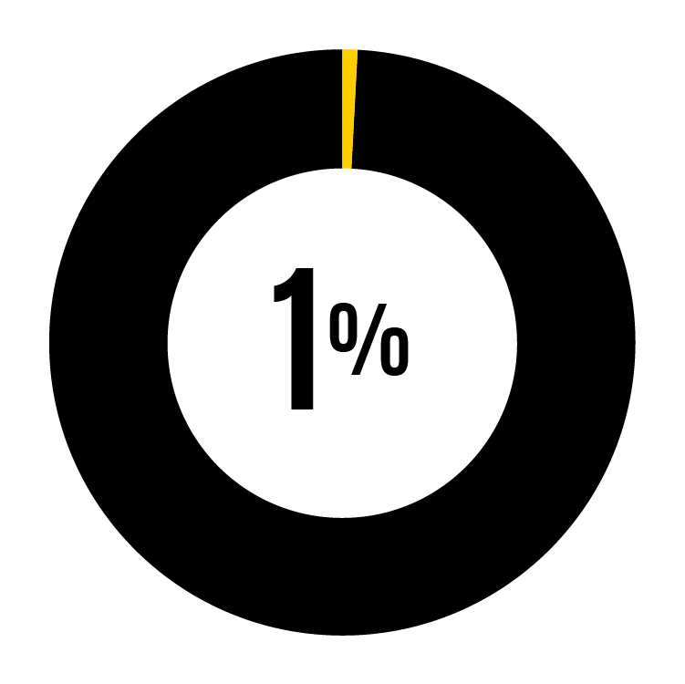
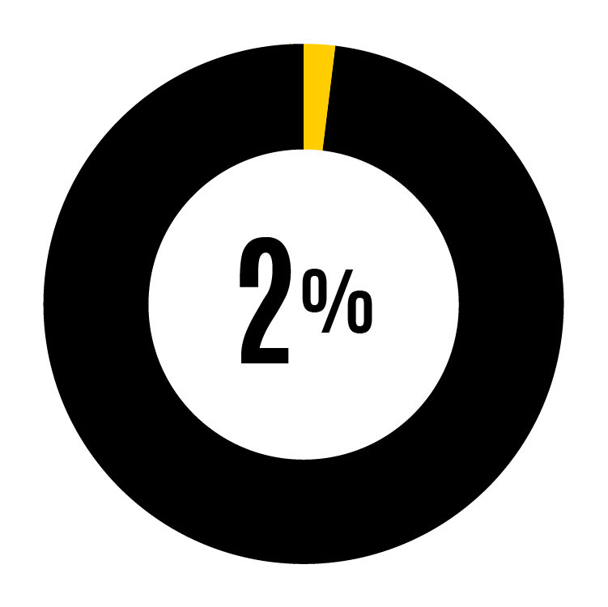
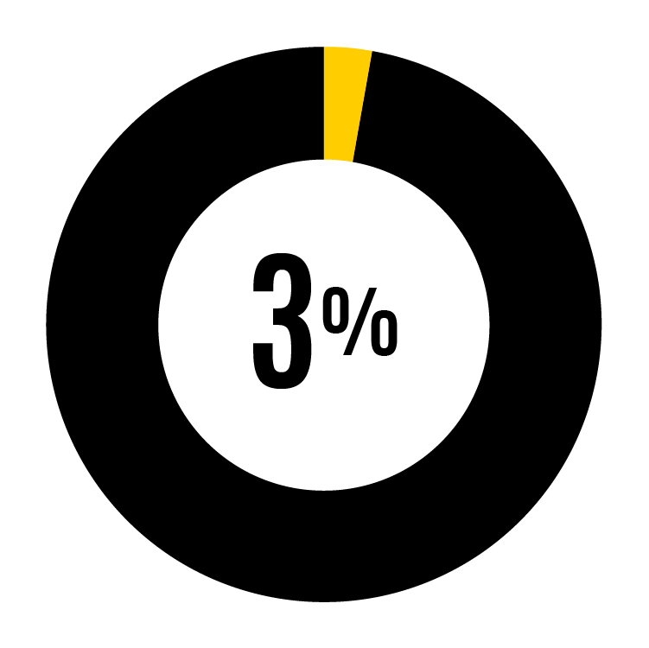
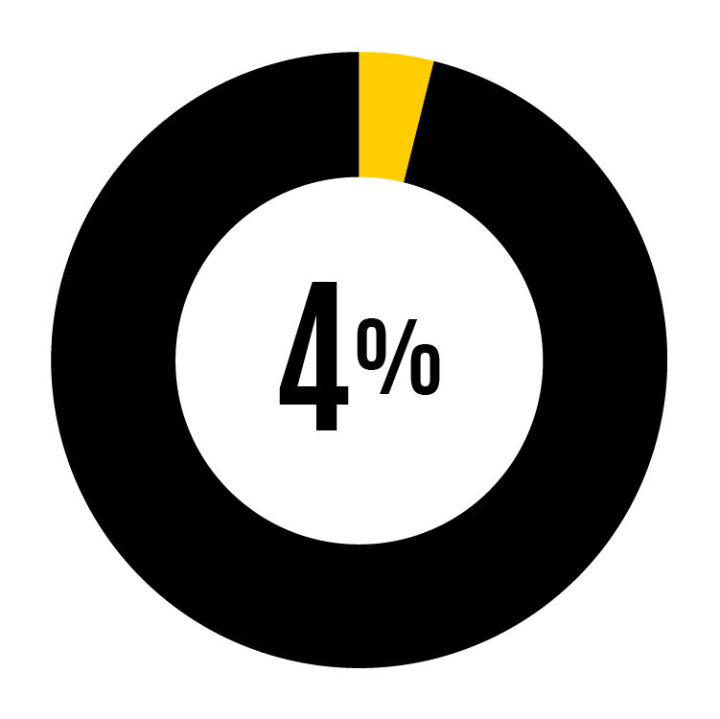
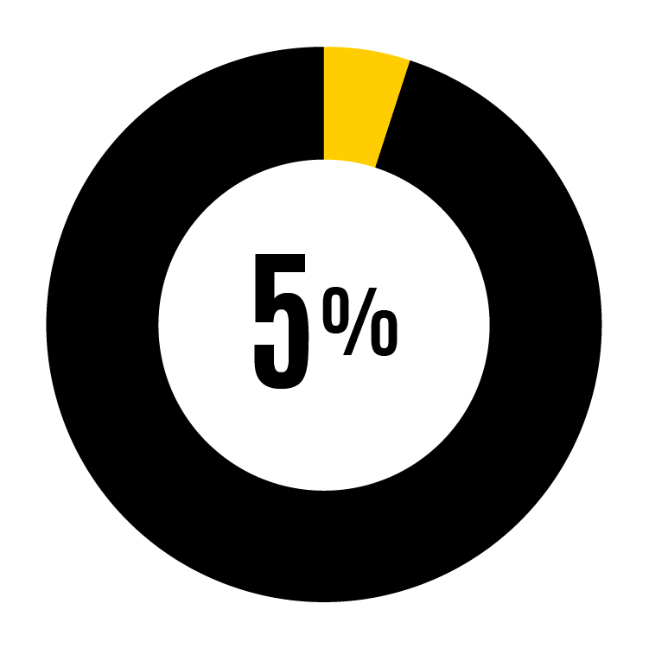
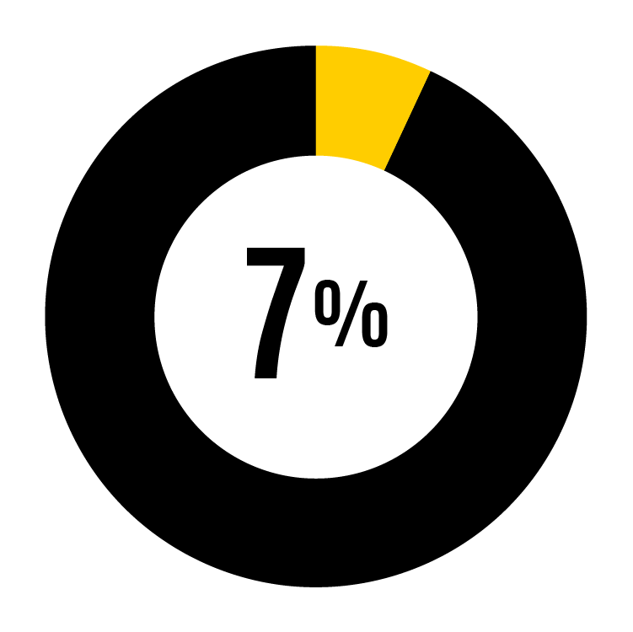
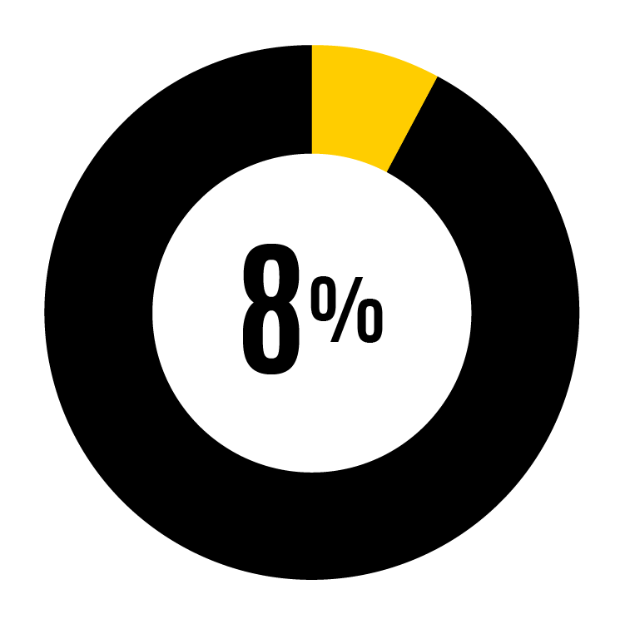
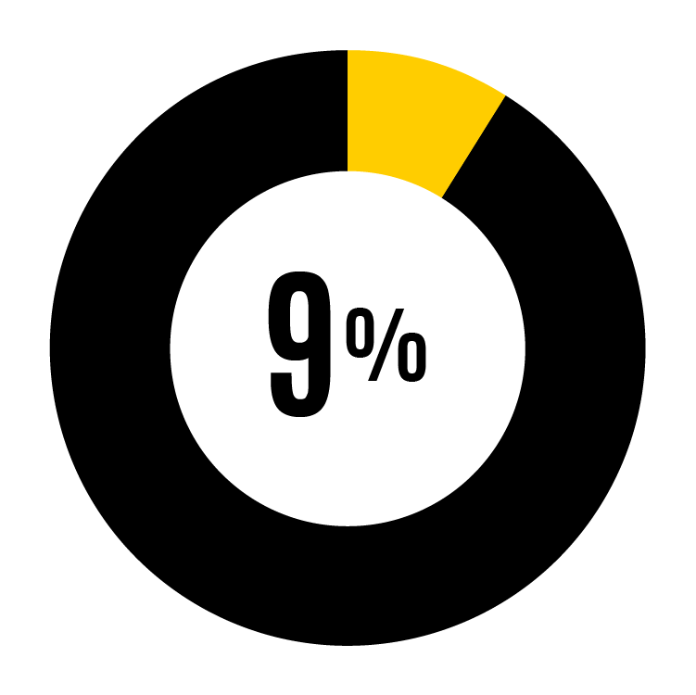
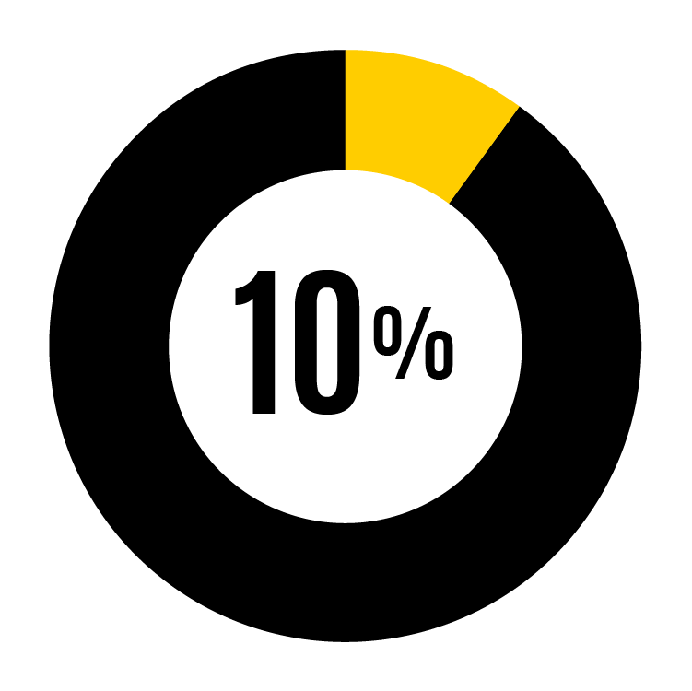
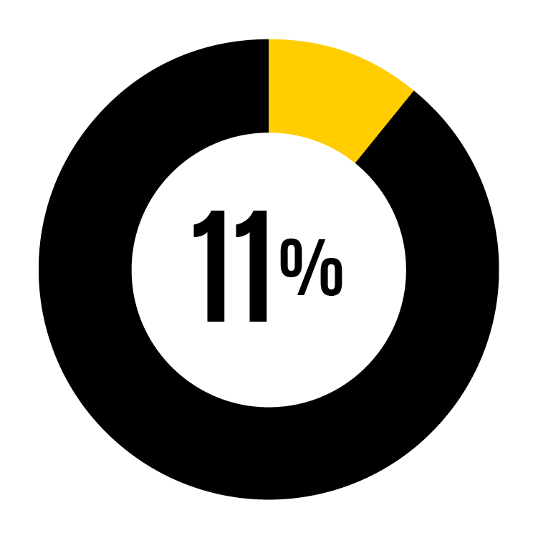
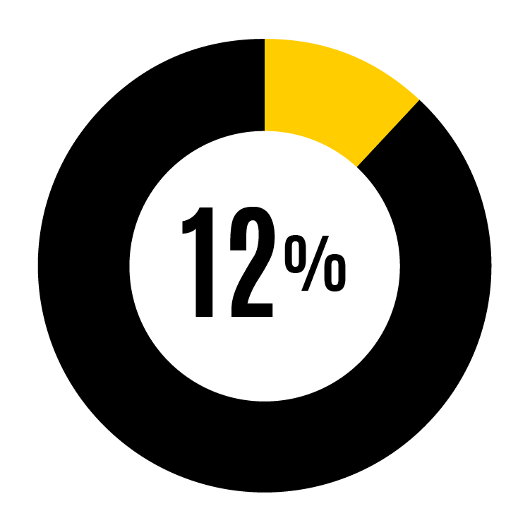
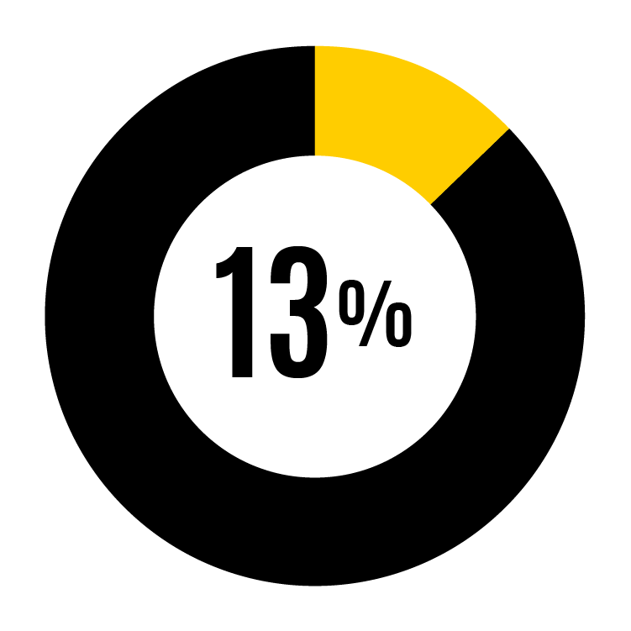
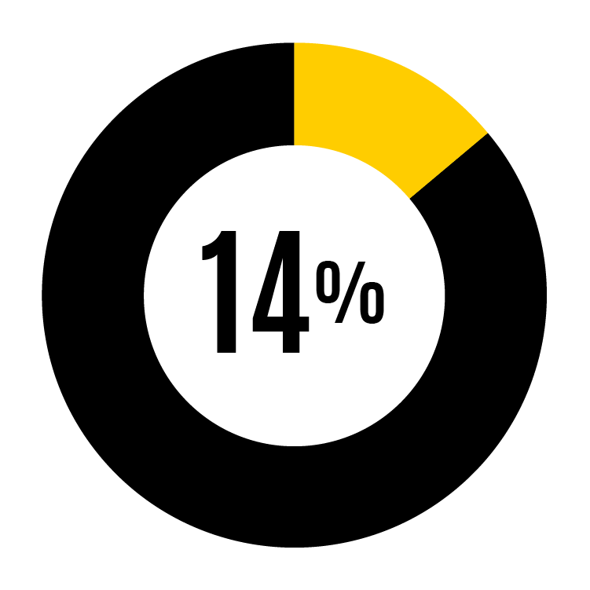
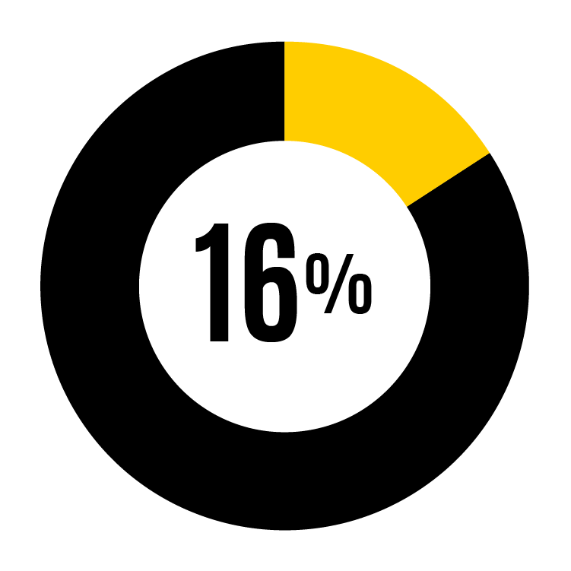
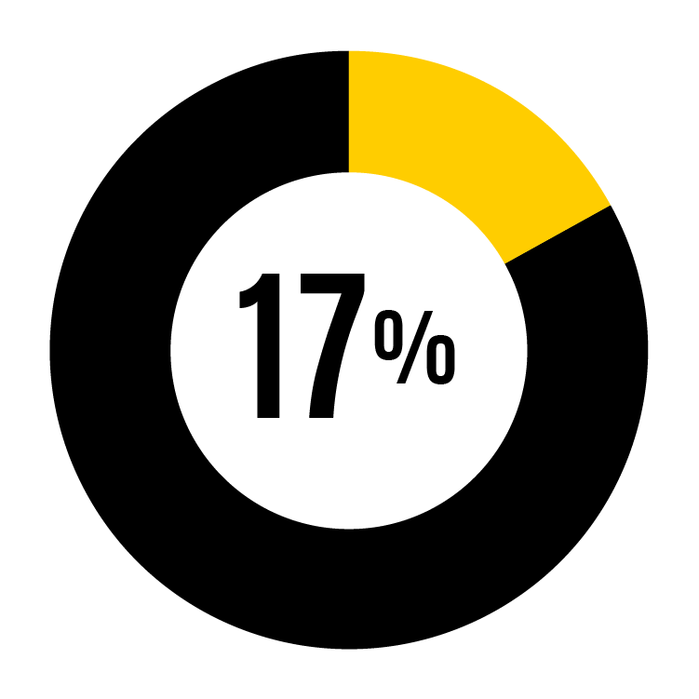
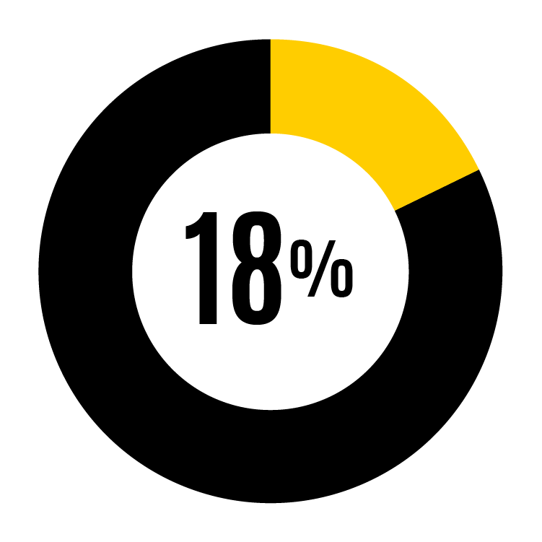
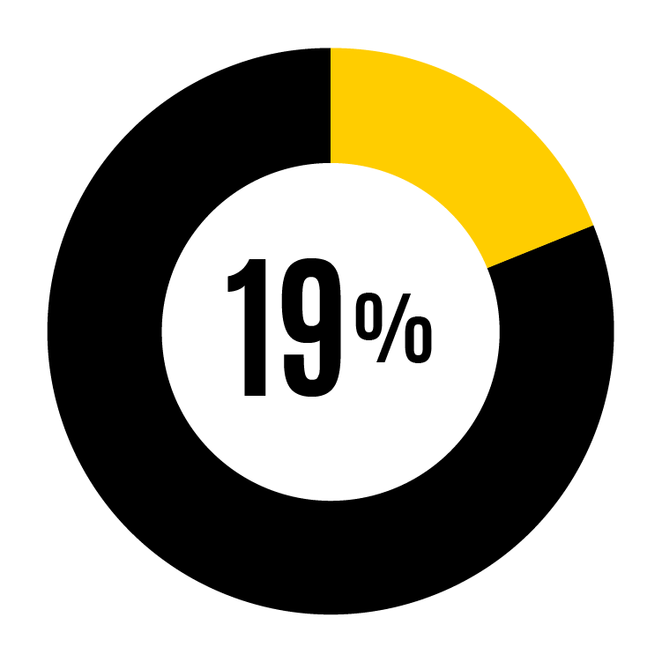
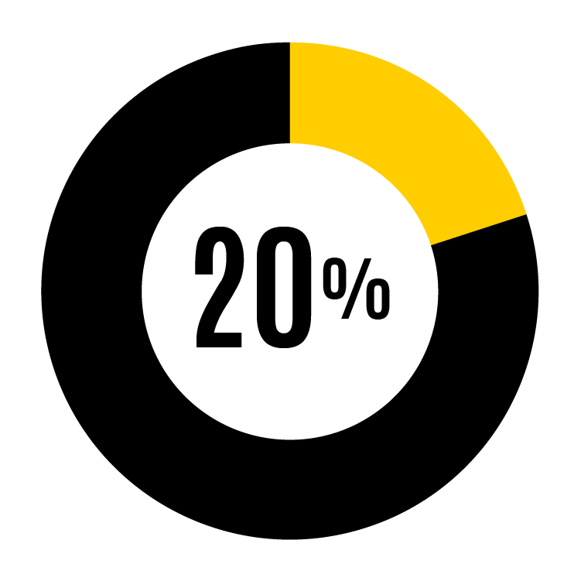
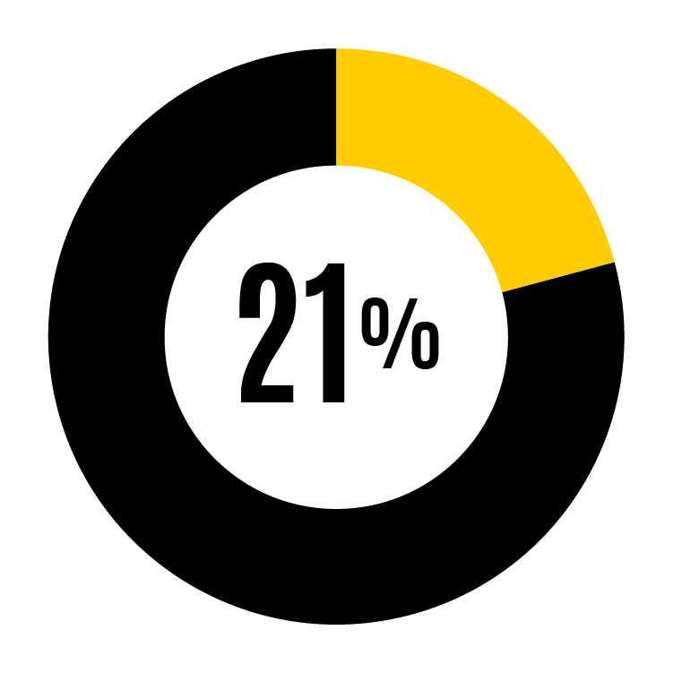
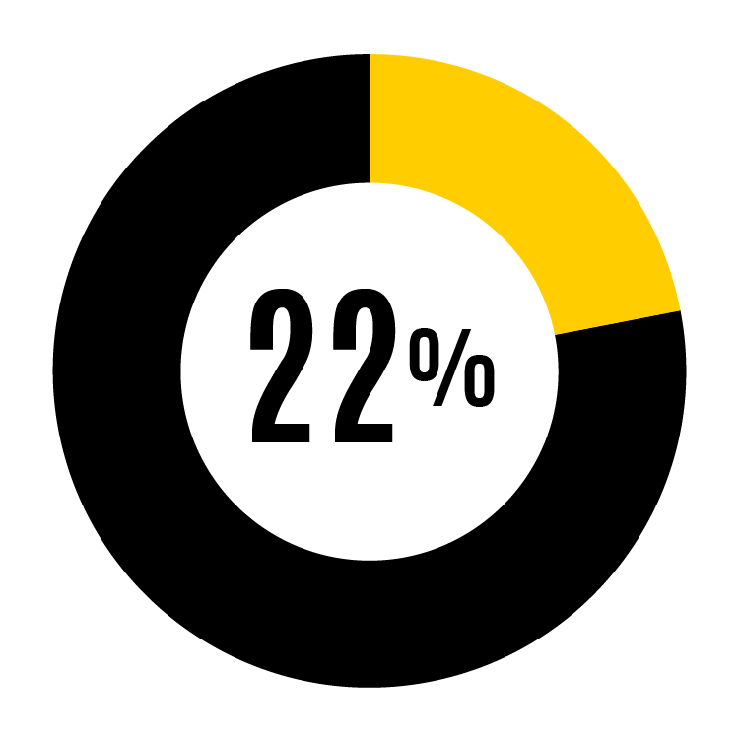
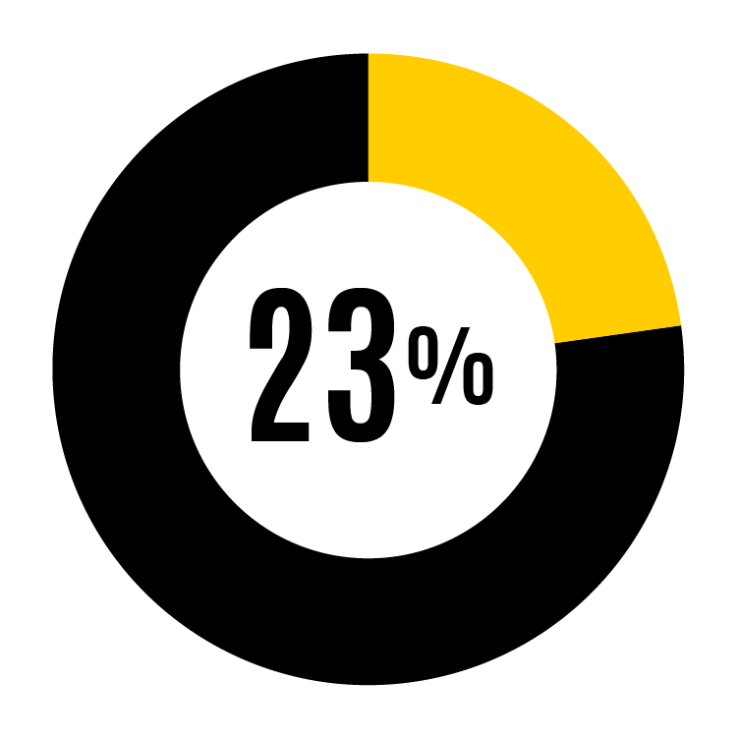
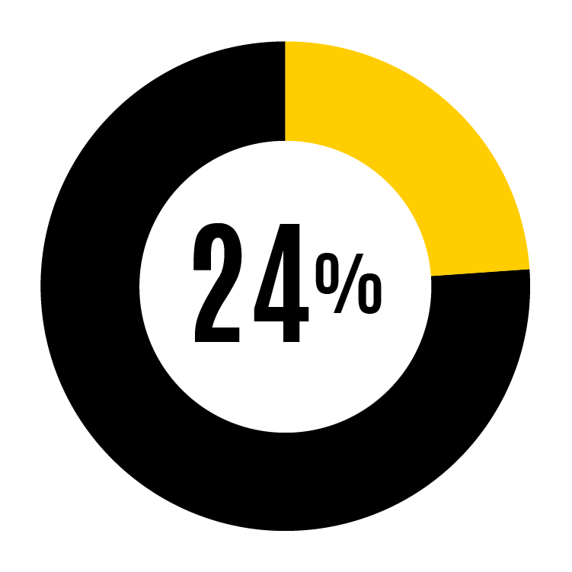
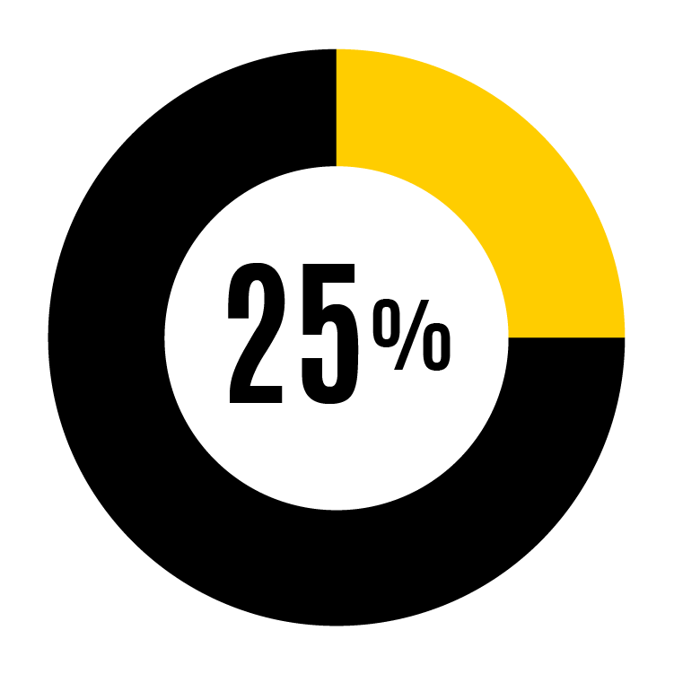
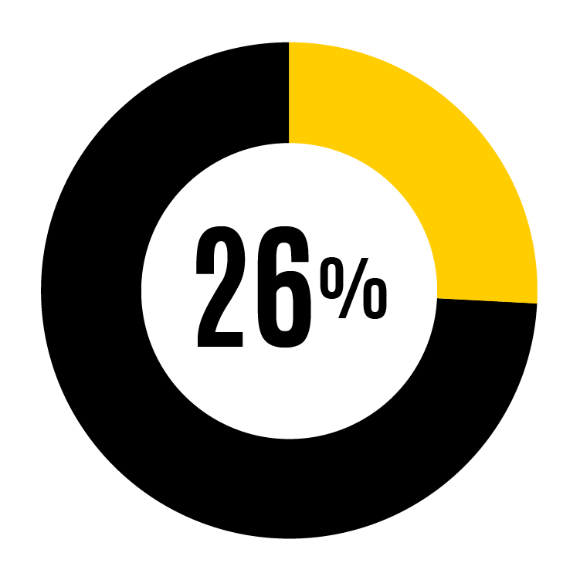
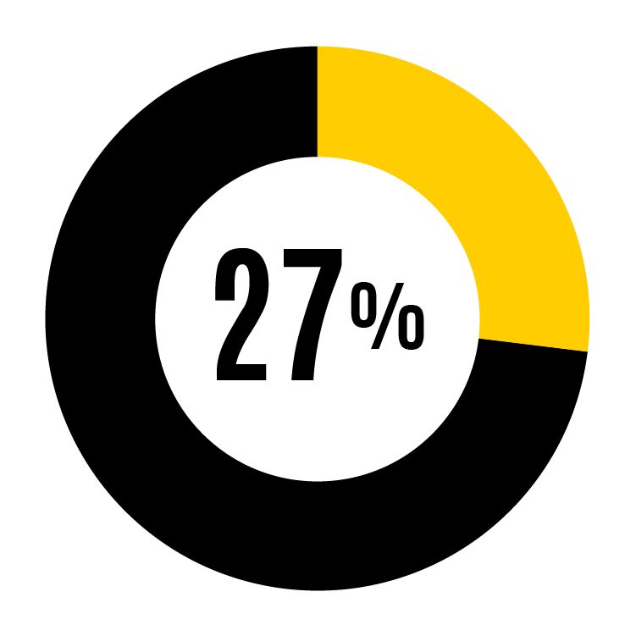
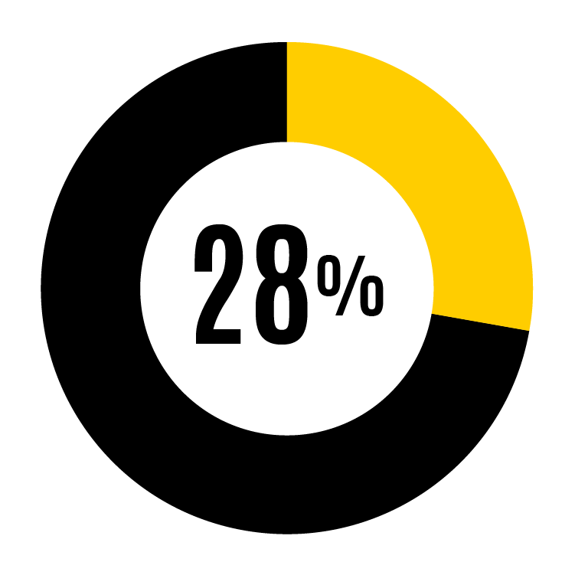
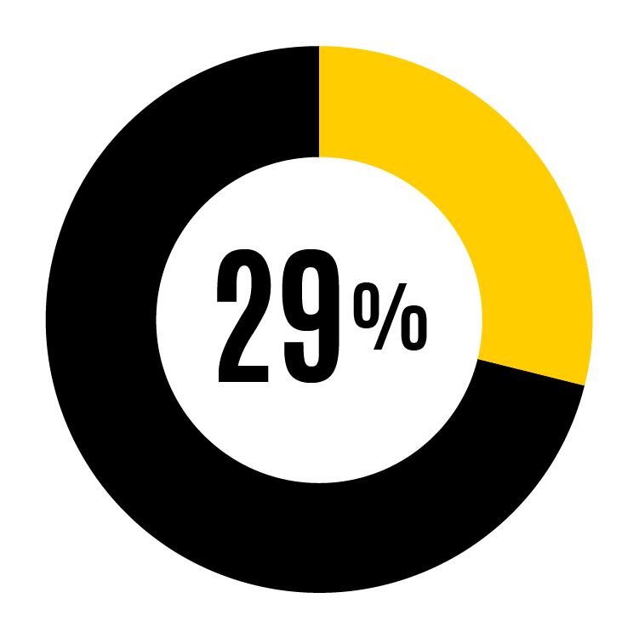
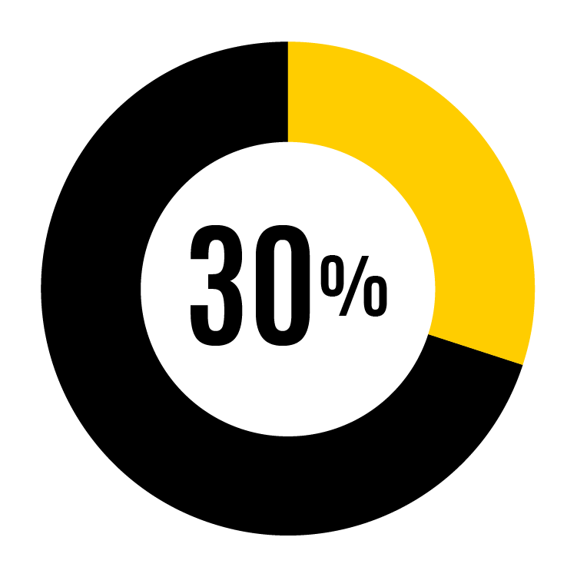
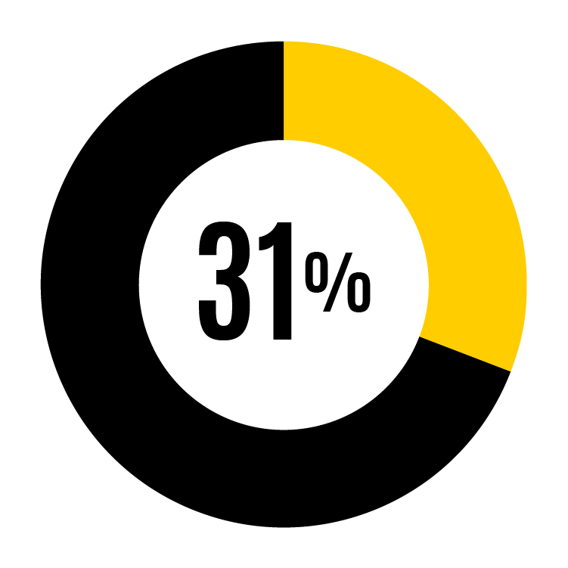
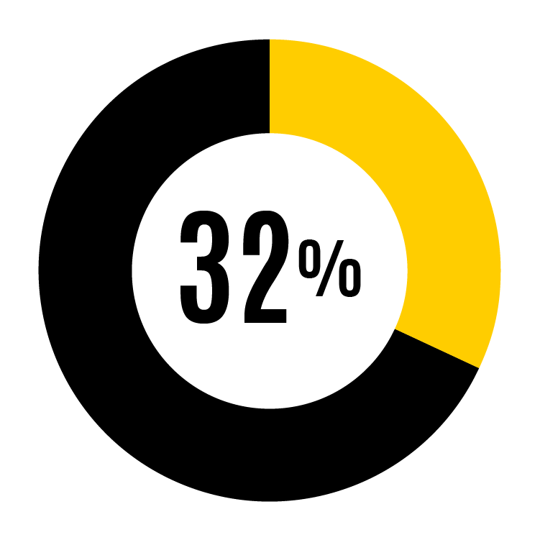
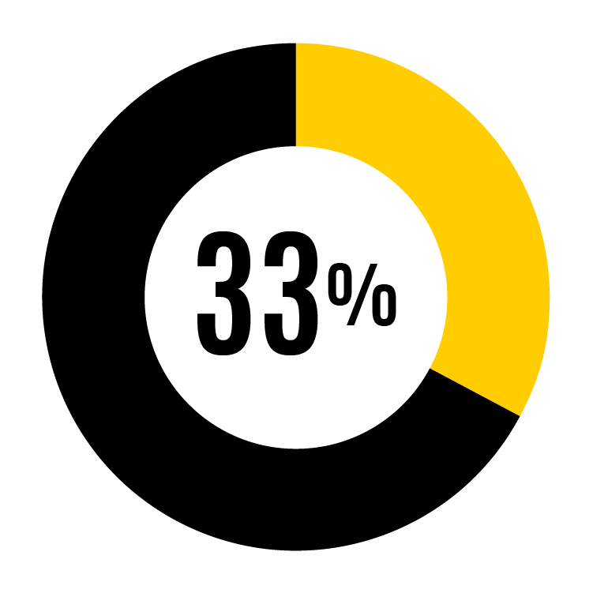
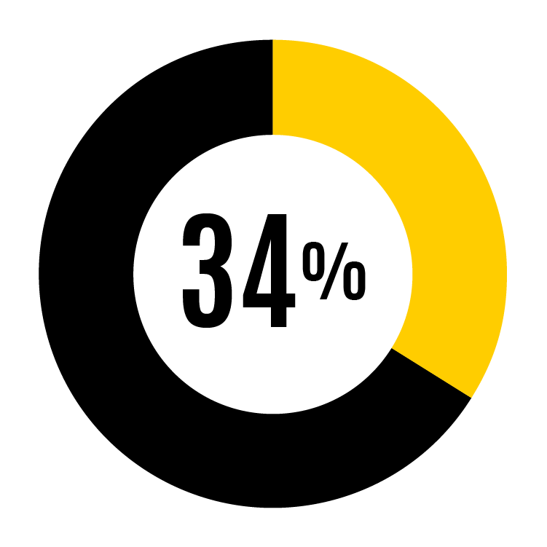
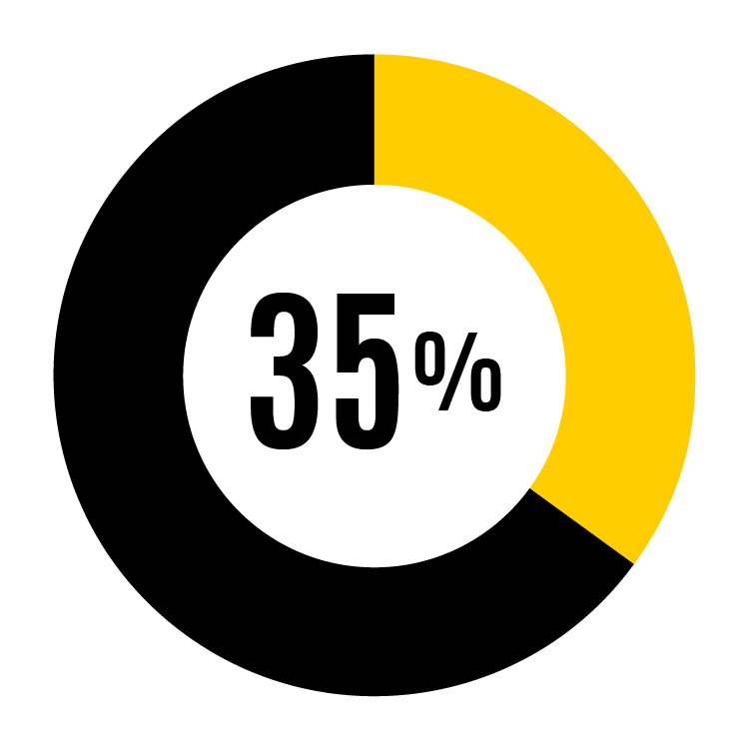
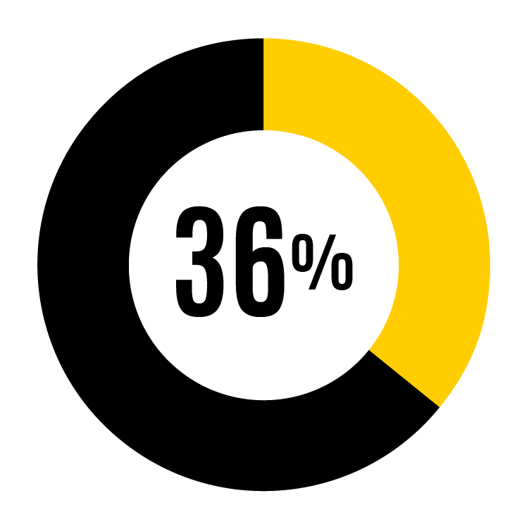
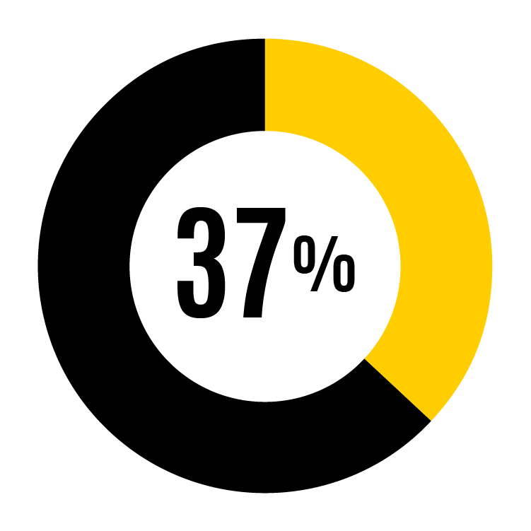
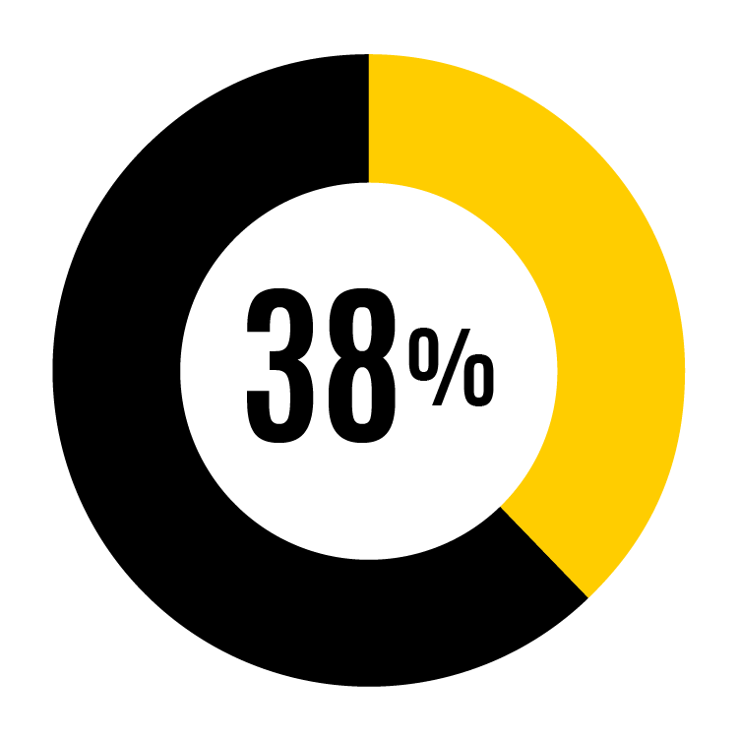
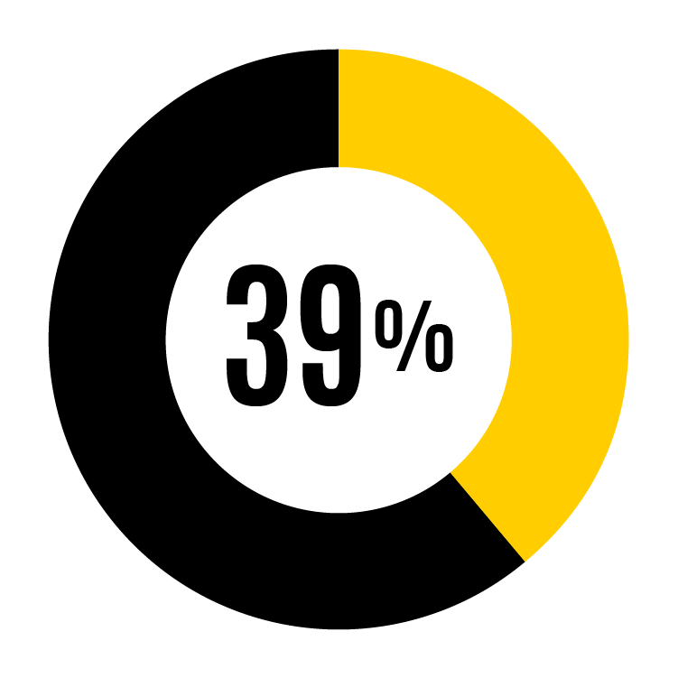
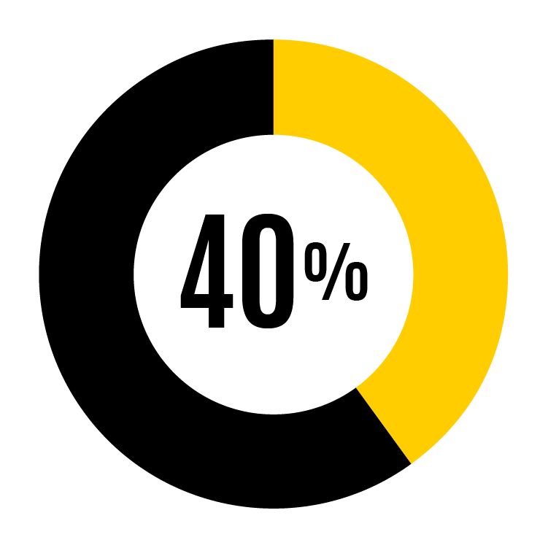
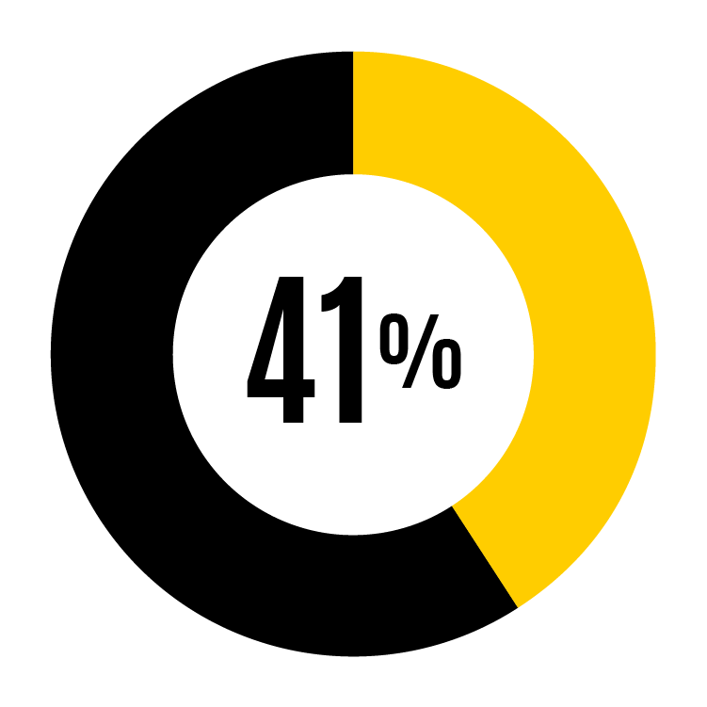
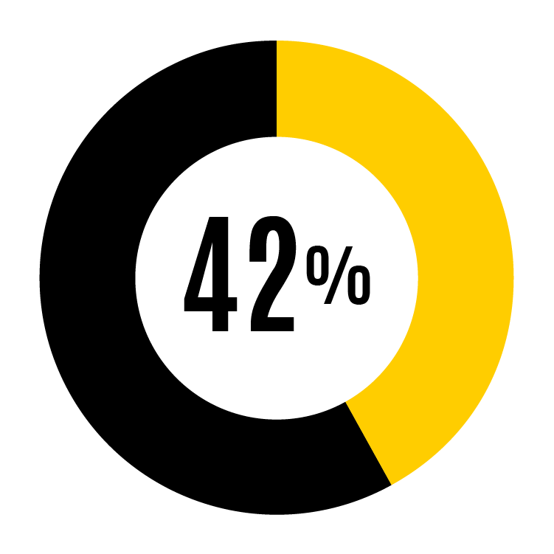
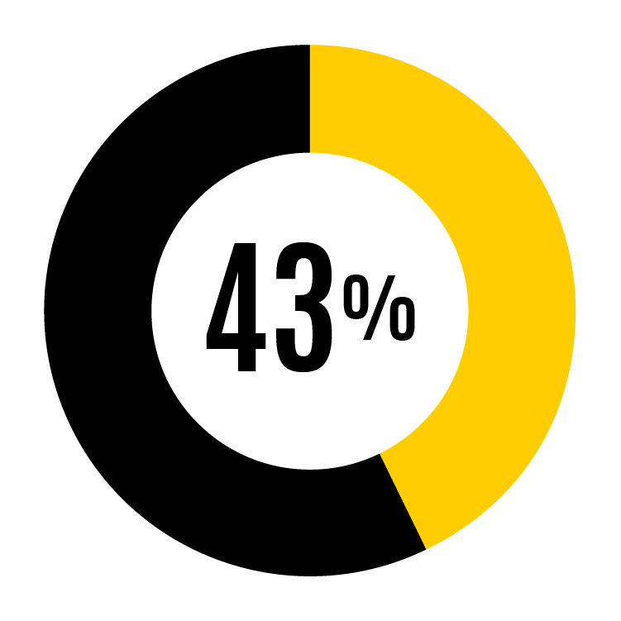
Standard Percentages

Slide 8
Standard Percentages (cont.)

Slide 9
Engagement: 3 types of behaviors
Physical
Mental
Emotional
I work with high energy
I exert my full effort
I devote a lot of my energy
I give my full attention to my job
I concentrate completely
My mind is focused on the work that I do
I put my emotions into what I do
I am emotionally connected
I put my feelings into my work
Notes:
Since 2018, WAI report includes an engagement index.
Validated scale provided by Dr. Eean Crawford, faculty member in the Tippie College of Business.
Engagement behaviors show how personally connected people are to their jobs in terms of giving their full effort, paying close attention to their work, and emotionally caring about what they do.
When faculty and staff are engaged, they are more likely to be productive, effective, and happy, and to create a positive work culture for themselves and others.

Slide 10
Engagement score result
Notes:
UI engagement score is 4. Very similar to 2020. Slighly lower than 2018.

Slide 11
Sample - org strengths/opportunities compared to UI
Strengths
Opportunities
% respondents that agree (strongly agree, agree, or slightly agree)

Slide 12
Next steps & resources
Action planning resources
Using Working at Iowa results
Next steps

